Slide 1
VideoPoet and CogVideoX
By Amit Prasad, Deeya Bodas, Lasya Neti, Rishi Sinha and Samvit Dedhia

Slide 2
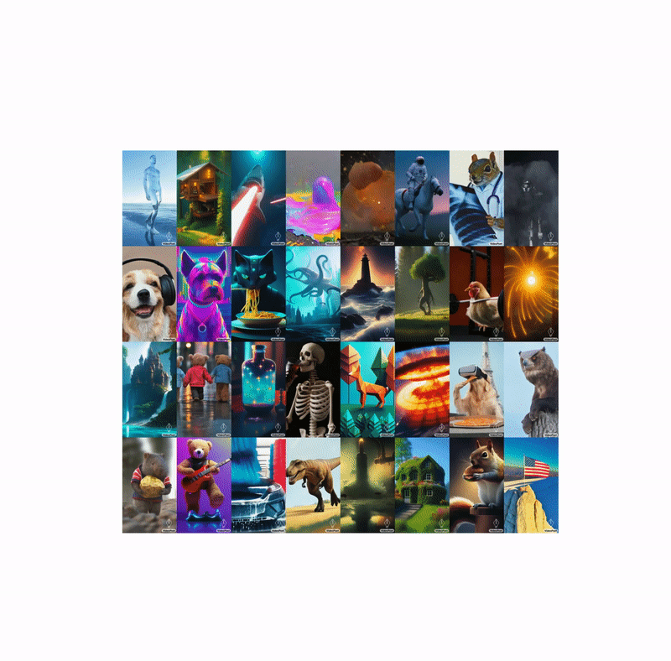
VideoPoet
Kondratyuk et. al. @ Google Research (June 2024)

Slide 3
VideoPoet: Overview
Model with high-quality video generation capabilities, with SOTA results
Multi-modal architecture that can…
…generate videos from text, images, and audio
…create clips of around 10 seconds long with consistency/coherence
…be used for zero-shot video generation, video editing, style transfer
…ingest simultaneous multi-modal input (e.g. video + text prompting)
Demonstrated that LLMs were competitive with SOTA for video generation (vs. diffusion)

Slide 4
VideoPoet: Key Ideas
Transformer/LLM-based video model, outcompetes diffusion models on video quality metrics
Reaps parallel advancements in transformer architecture, training/inference methods, efficiency, etc.
Transformer architecture allows similar autoregressive methods for visual output.
Consistency between frames
Motion realism/coherence
Better zero shots: input understanding/reasoning capabilities

Slide 5
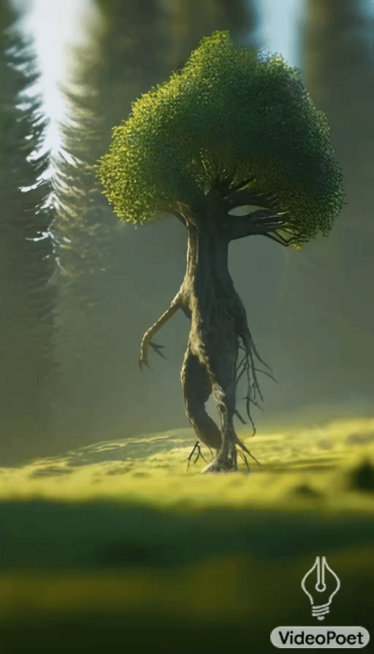
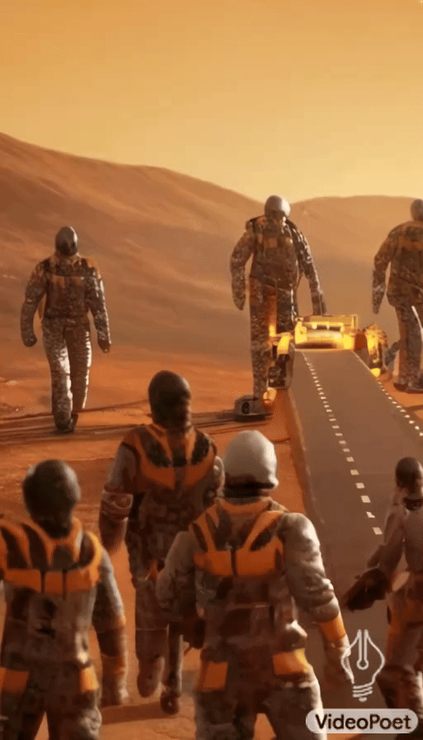
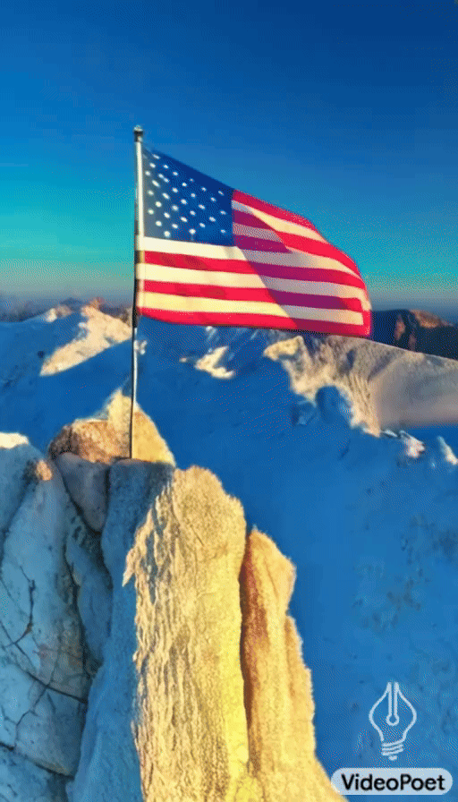

Slide 6
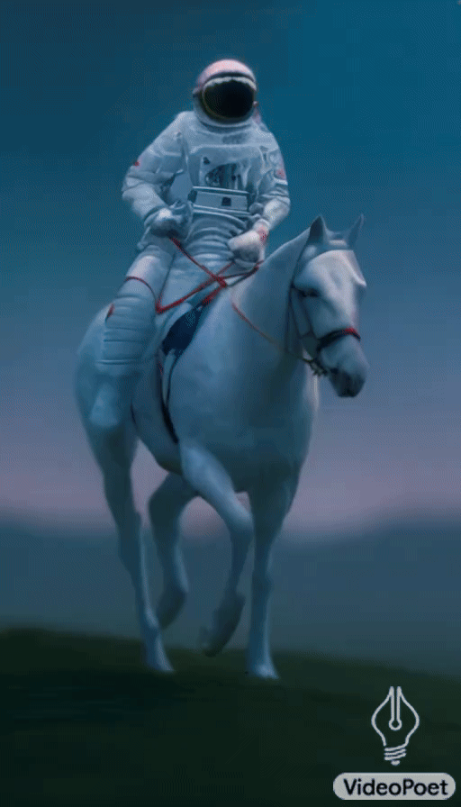
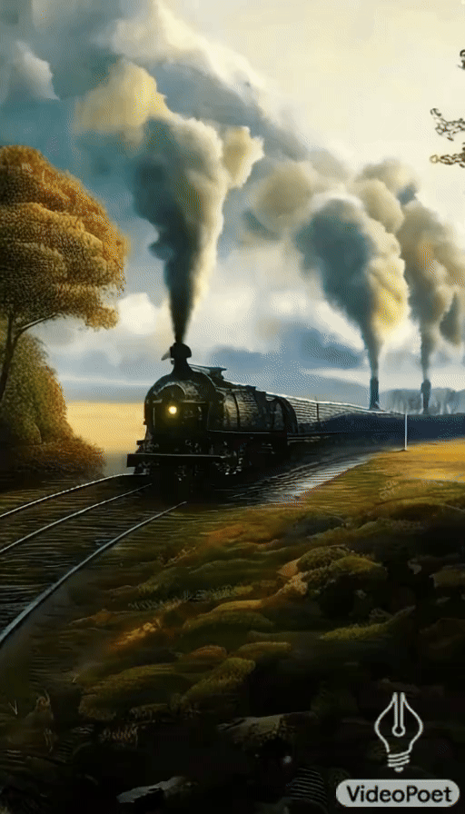


Slide 7
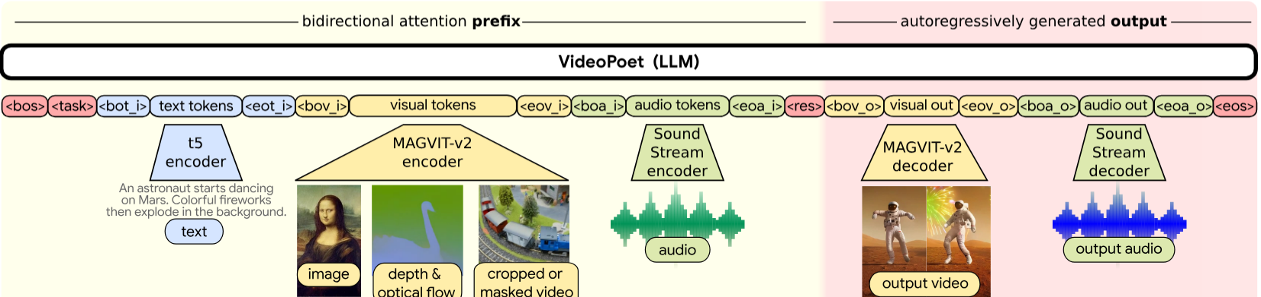
High-level Architecture
Input can incorporate text, audio, and visual modalities simultaneously
Shared vocabulary, whilst using different tokenizers for each modality.
Autoregressive model, outputs both video and audio tokens
Still uses bidirectional attention after processing
“Super-resolution” (SR) post-processing transformer to reduce computational burden of generating high resolution video from output tokens
Notes:
Some notes for this

Slide 8
Model Overview
Tokenization → convert all modalities into discrete tokens with shared vocab
MAGVIT-v2 for images and video to make latent shapes which we can flatten
Sound-Stream for audio with compression using Residual Vector Quantization (RVQ)
Frozen T5 XL Encoder is used for text modality
Super Resolution Module (SR)
Generating high resolution video is hard because of the number of tokens
Solution is to use a transformer for refining low-quality images into high-quality representations before generation begins
Utilizes windowed self-attention and cross-attention for upscaling
Autoregressive model for output Generation
Generates video and audio tokens sequentially using same tokenizers
Notes:
Some notes for this

Slide 9
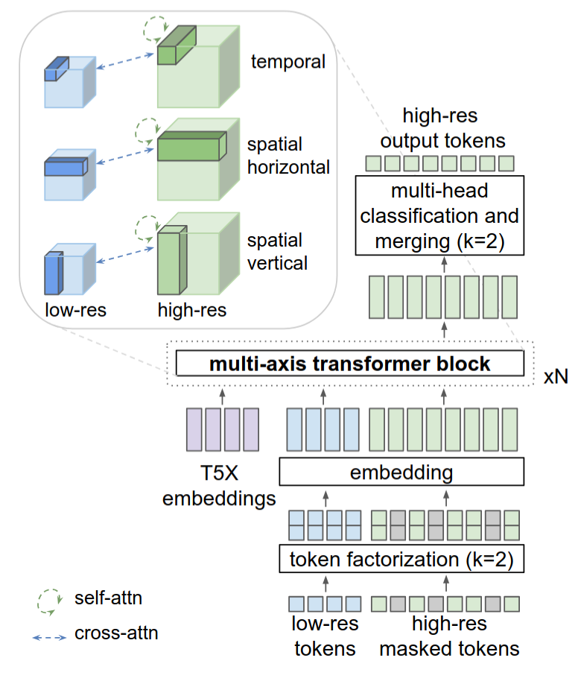
Training SR
Train SR transformer
High res videos are downsampled
token factorization
Adding noise
Refinement is non-autoregressive
Cascade of 2 stages to gradually refine images

Slide 10
Overall Model training
Take in all input modalities
Conditions on the prefix (e.g., text or low-res video) and predicts the next set of tokens
We apply loss function on generated tokens
Goals: Model learns to generate single frame images, video tokens at 2 resolutions, and also stylization
Stylization:
During training, the model reconstructs ground truth video from inputs
In inference, the text prompt can be adjusted for a new style
Use alternating gradient descent for efficient training so we don’t have to add padding

Slide 11
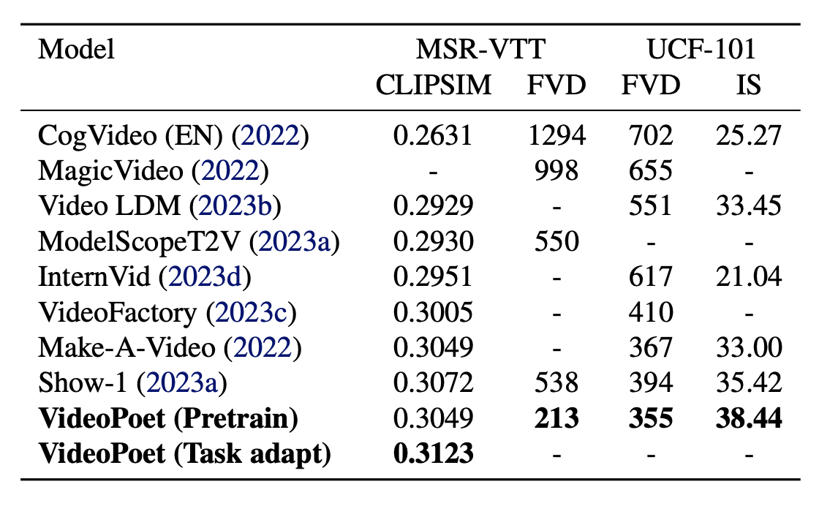
Model Evaluation - Quantitative
Evaluation Metrics:
CLIP Similarity
Frechet Video Distance
Inception Score
Key Takeaways:
VideoPoet outperforms most competitors in video realism
Ranks among the best in matching text prompts
Fine-tuning improves results even further, making VideoPoet one of the best AI models for video generation.
Notes:
Deeya
Notes to Discuss/Speech:
So let’s move on to discuss how the researchers who wrote this paper evaluated VideoPoet, by starting with the automated testing.
Why do we need automated testing? AI-generated videos need consistent, repeatable testing to compare models fairly.
Human evaluations are useful but can be subjective and time-consuming, so automated testing can fill that gap at scale.
Key Metrics Used for Evaluation
CLIP Similarity (CLIPSIM)
Measures how well the generated video matches the input text prompt.
A higher score means a better match between the video content and the description.
Example: If the prompt is "A dog running in the park," a high CLIP score means the video contains a dog running in a park rather than something unrelated.
Frechet Video Distance (FVD)
Measures how natural the motion looks by comparing AI-generated videos to real-world videos.
A lower score means the video looks more realistic with smoother motion.
Example: If an AI generates a video of a bouncing ball, but the movement is jerky or unnatural, FVD will be high (bad). If the ball moves smoothly, FVD will be low (good).
Inception Score (IS)
Evaluates video diversity and realism by checking how many unique, clear objects appear in the video.
A higher score means the video looks more varied and high-quality.
Example: A video with different frames, varying motion, and distinct objects will score higher than one where the same object repeats or looks blurry.
Takeaways:
VideoPoet outperforms most competitors in video realism (FVD is lowest).
It also ranks among the best in matching text prompts (CLIP Similarity).
Fine-tuning improves results even further, making VideoPoet one of the best AI models for video generation.

Slide 12
Model Evaluation - Human Evaluation
Evaluation Metrics:
Text Fidelity – Does the video match the prompt accurately?
If an AI misinterprets "beach" and places the horse on grass, this score will be low.
Video Quality – How clear, sharp, and visually appealing is the video?
Higher quality = better colors, textures, and fewer distortions.
Motion Interestingness – Does the movement look engaging and natural?
If the model generates stiff or unnatural movements, this score will be low.
Motion Realism – Does the video move like a real-world recording?
If AI-generated motion looks physically unnatural, humans will rate it lower.
Temporal Consistency – Does the video stay stable over time?
Some AI models create videos where objects flicker or disappear over time, leading to a low temporal consistency score.
Notes:
Deeya
Notes to Discuss/Speech:
While automated tests provide valuable insights, they don't always capture subjective aspects of video quality.
Humans can spot issues like unnatural animation, missing details, or odd textures that automated testing may fail to detect.
Example: If an AI generates a cat jumping, the motion might look fine based on FVD, but humans may notice that the cat's tail suddenly disappears mid-air.
Text Fidelity – Does the video match the prompt accurately?
Example: If the text prompt is "A horse galloping on a beach," does the generated video actually show a horse running on sand, or does it generate a different scene?
If an AI misinterprets "beach" and places the horse on grass, this score will be low.
Video Quality – How clear, sharp, and visually appealing is the video?
Higher quality = better colors, textures, and fewer distortions.
Some models may generate blurry or pixelated videos, which would score lower.
Motion Interestingness – Does the movement look engaging and natural?
Example: A person running through a forest should have fluid motion rather than looking like a slideshow.
If the model generates stiff or unnatural movements, this score will be low.
Motion Realism – Does the video move like a real-world recording?
Example: If a ball is rolling down a hill, it should speed up due to gravity, not move at a constant speed.
If AI-generated motion looks physically unnatural, humans will rate it lower.
Temporal Consistency – Does the video stay stable over time?
Example: If a dog is running, does it keep its size and shape in every frame, or does it distort as it moves?
Some AI models create videos where objects flicker or disappear over time, leading to a low temporal consistency score.
Takeaways from Human Testing:
VideoPoet is best at generating realistic motion (highest Motion Realism and Interestingness scores).
It beats most models in keeping objects stable over time (Temporal Consistency).
However, Lumiere slightly outperformed it in Video Quality, meaning VideoPoet can improve its fine details.

Slide 13
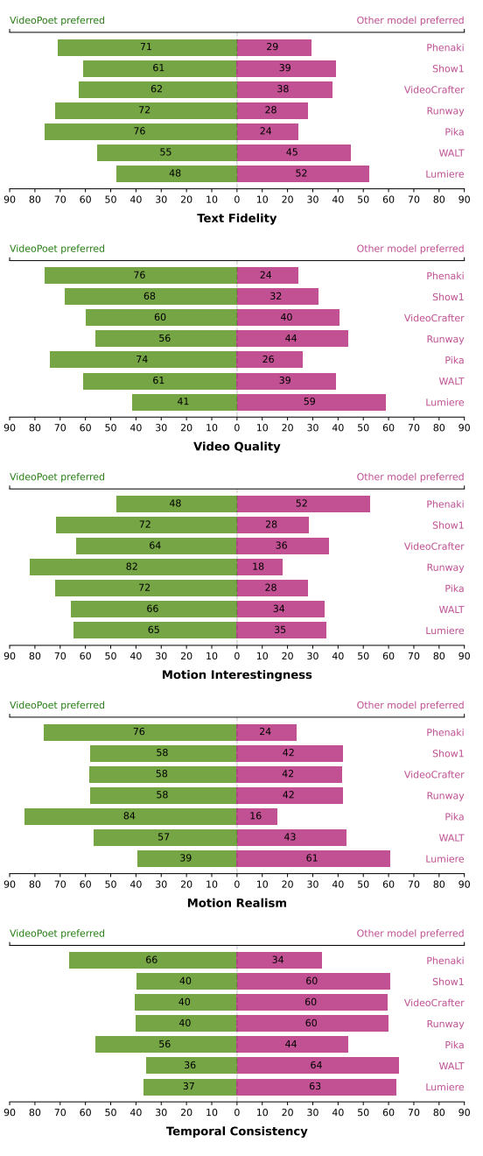
Model Evaluation - Human Evaluation
Key Takeaways:
VideoPoet is best at generating realistic motion (highest Motion Realism and Interestingness scores).
VideoPoet is best at sticking to the prompt
It performs poorer than most competing models in keeping objects stable over time (Temporal Consistency).
Lumiere slightly outperformed it in most categories, except for Motion Interestingness
Notes:
Deeya
Notes to Discuss/Speech:
While automated tests provide valuable insights, they don't always capture subjective aspects of video quality.
Humans can spot issues like unnatural animation, missing details, or odd textures that AI might not detect.
Takeaways from Human Testing:
VideoPoet is best at generating realistic motion (highest Motion Realism and Interestingness scores).
VideoPoet is best at sticking to the prompt
It performs poorer than most competing models in keeping objects stable over time (Temporal Consistency).
Lumiere slightly outperformed it in most categories, except for Motion Interestingness

Slide 14
Strengths and Weaknesses
Strengths
Text-to-video, image-to-video, video-to-video editing, and audio-to-video support
Smooth motion, less flickering/frame inconsistency than diffusion models
Achieves SOTA zero-shot performance
Weaknesses
Tokenization loses information in fine textures and visual details
Diffusion-based models generate better single frames (images)
Extending the video past 10 seconds causes motion inconsistencies.

Slide 15

CogVideoX

Slide 16
CogVideoX: Overview
Challenges in Previous Models:
Short durations: Previous models could only generate a few seconds of video.
Limited motion: Many models produced static or minimally animated videos.
Poor text-video alignment: Inaccurate scene generation from text descriptions.
What Does CogVideoX Achieve?
10-second, high-resolution videos (768×1360, 16 fps).
Improved coherence and motion dynamics compared to previous models.
Better alignment between text and generated video content.
One of the first commercial-grade open-source video generation model
Notes:
Deeya
Challenges in Previous Models:
Short durations: Previous models could only generate a few seconds of video.
Limited motion: Many models produced static or minimally animated videos.
Poor text-video alignment: Inaccurate scene generation from text descriptions.
What Does CogVideoX Achieve?
10-second, high-resolution videos (768×1360, 16 fps).
Improved coherence and motion dynamics compared to previous models.
Better alignment between text and generated video content.
First commercial-grade open-source video generation model

Slide 17
CogVideoX: Key Ideas
Uses a 3D Variational Autoencoder (VAE) to compress videos spatially and temporally, improving compression rates and frame continuity
Implements an Expert Transformer with Adaptive LayerNorm to fuse text and video data to generate more accurate and temporally consistent videos
Created a video captioning pipeline to enhance the model’s training data source
Notes:
Deeya
Efficient Video Compression: Uses a 3D Variational Autoencoder (VAE) to compress videos spatially and temporally, improving compression rates and frame continuity
Enhanced Text-Video Alignment: Implements an Expert Transformer with Adaptive LayerNorm to fuse text and video data to generate more accurate and temporally consistent videos
Created a video captioning pipeline to enhance the model’s training data source which improves the model’s performance in motion coherence and semantic alignment

Slide 18
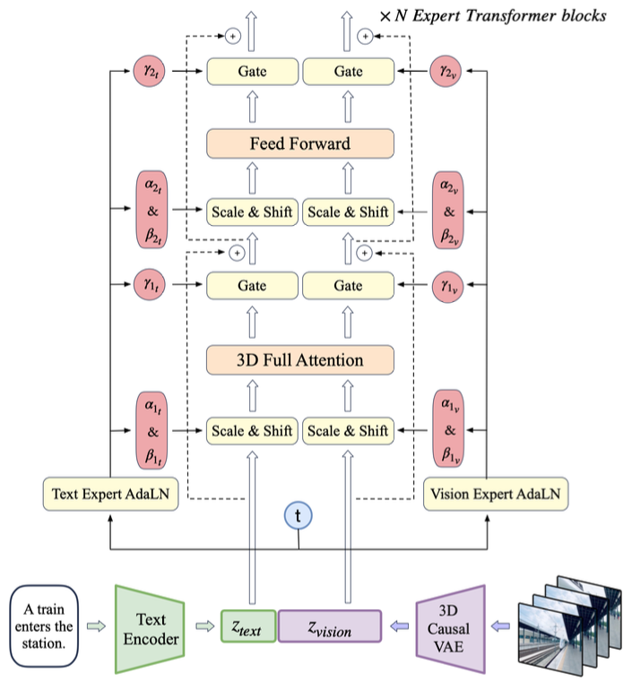
Model Architecture
3D Causal VAE
Compresses video spatially & temporally.
Reduces sequence length for efficiency.
Optimized for large-scale video data processing.
Expert Transformer
Uses patchified video representation.
3D-RoPE Embeddings for spatial-temporal encoding.
Adaptive LayerNorm (AdaLN) for improved text-video fusion.

Slide 19
Process Flow
Encoding:
Video is divided into patches for transformer processing.
Text and Video embeddings are computed using T5 model.
Attention Mechanisms:
Concatenated text & video processed using transformer blocks.
Decoding and Reconstruction
Transformed latents are converted into full-resolution video frames.
3D Causal VAE decoder reconstructs Hi-Fi output videos.

Slide 20
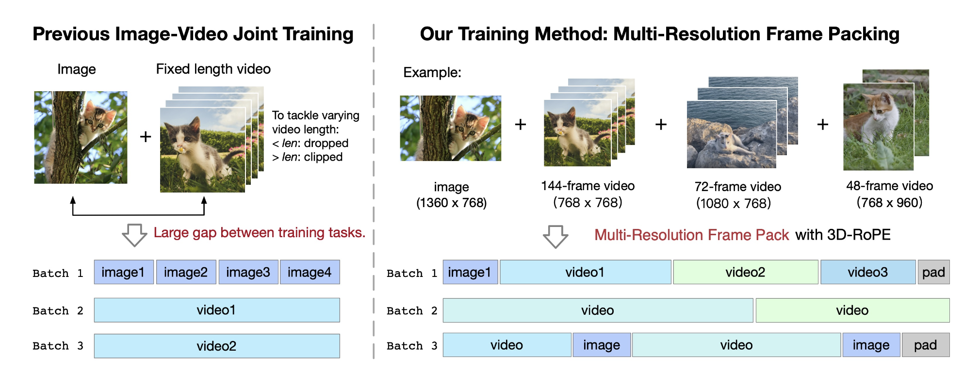
Training Method
Progressive Training
Trains at increasing resolutions: 256px → 512px → 768px
Multi-Resolution Frame Pack
Batches videos of varying durations & resolutions for efficient training
Fine-Tuning with High-Quality Data
Filters out low-quality training samples to refine final output quality

Slide 21
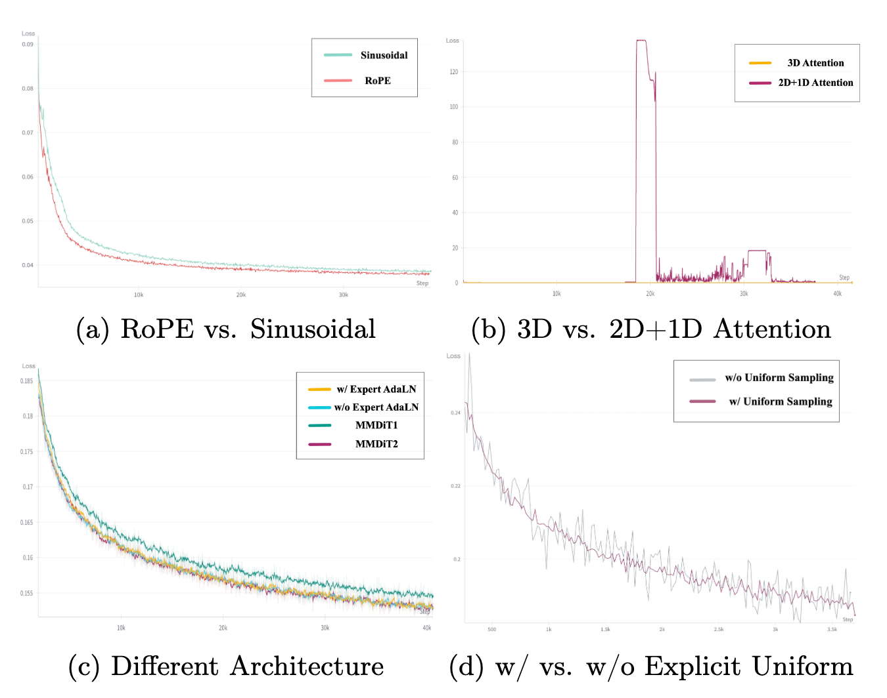
Training Results
3D RoPE shown to converge much faster during training
Adaptive LayerNorm simplifies architecture and outperforms during training
3D Full Attention shown to be necessary to prevent collapse during training
Explicit Uniform Sampling stabilizes performance during training, better overall performance

Slide 22
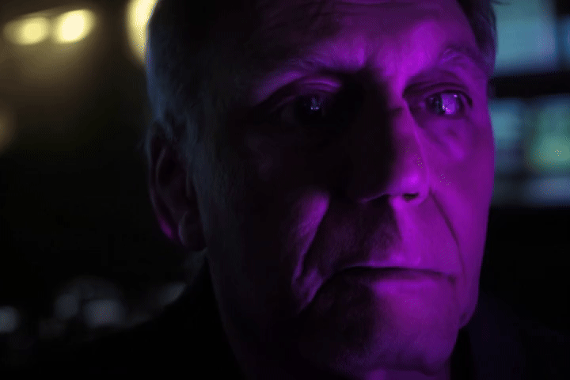
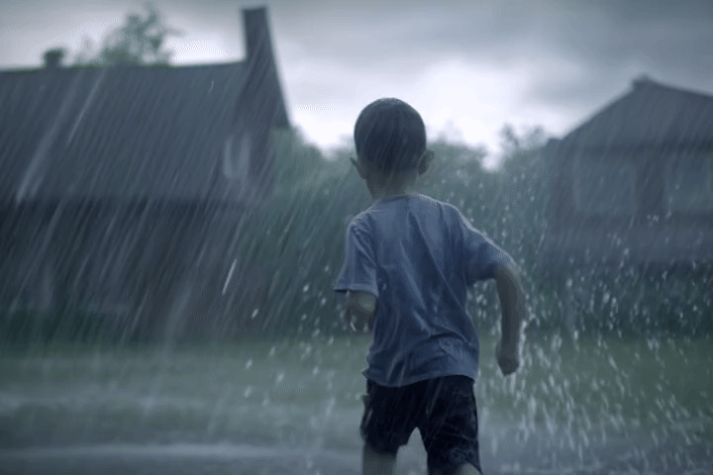

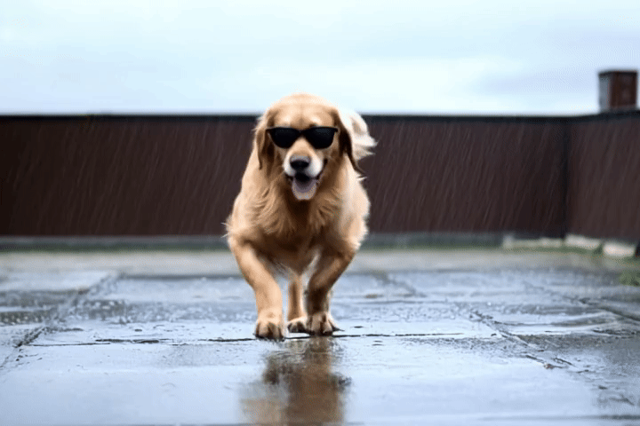

Slide 23
Evaluation Metrics
Human Perception-based:
Human Action
Scene
Multiple Objects
Appearance Style
Dynamism metrics:
Dynamic Quality/Degree
MTScore
Prevents static videos from scoring well, rewarding “rich content”

Slide 24
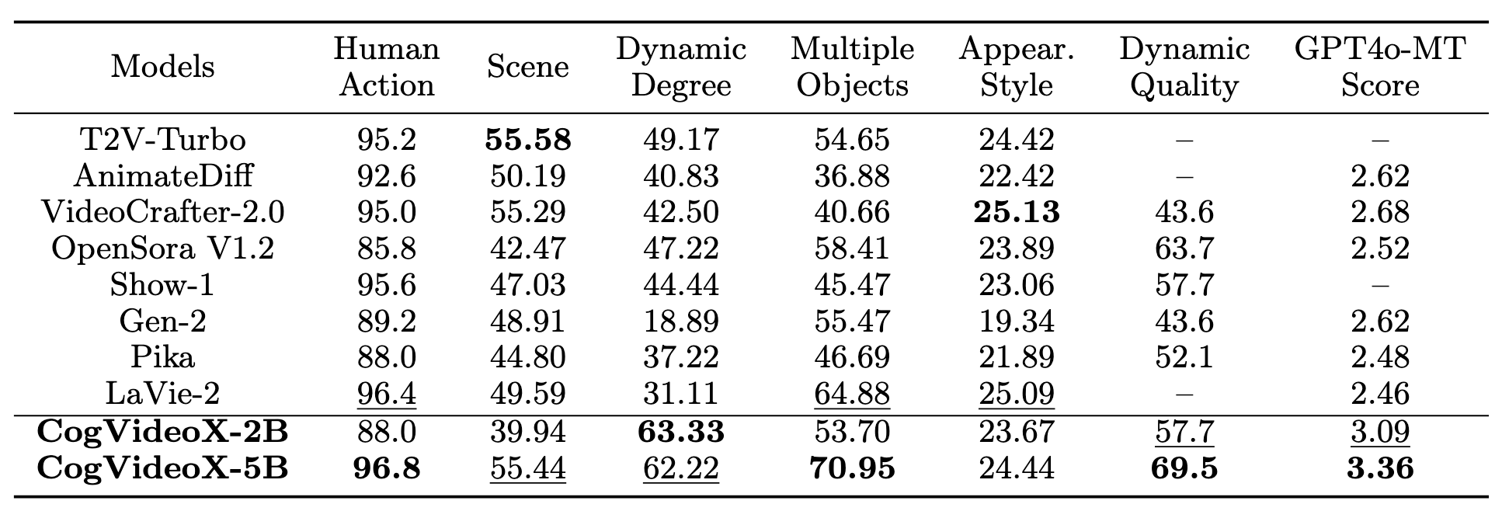
Takeaways:
Matches or outperforms existing models in all metrics.
Significant outperformance in Dynamism metrics
Human evaluation consistently rates CogVideoX over Kling, a closed SOTA competitor

Slide 25
CogVideoX Strengths and Weaknesses
Strengths:
Long duration video generation
Reduces flickering and is smooth due to 3D-VAE
Better text-video alignment
Can capture more complex scenes
Weaknesses:
Computationally Expensive
Still could struggle with longer text prompts due to limited context

Slide 26
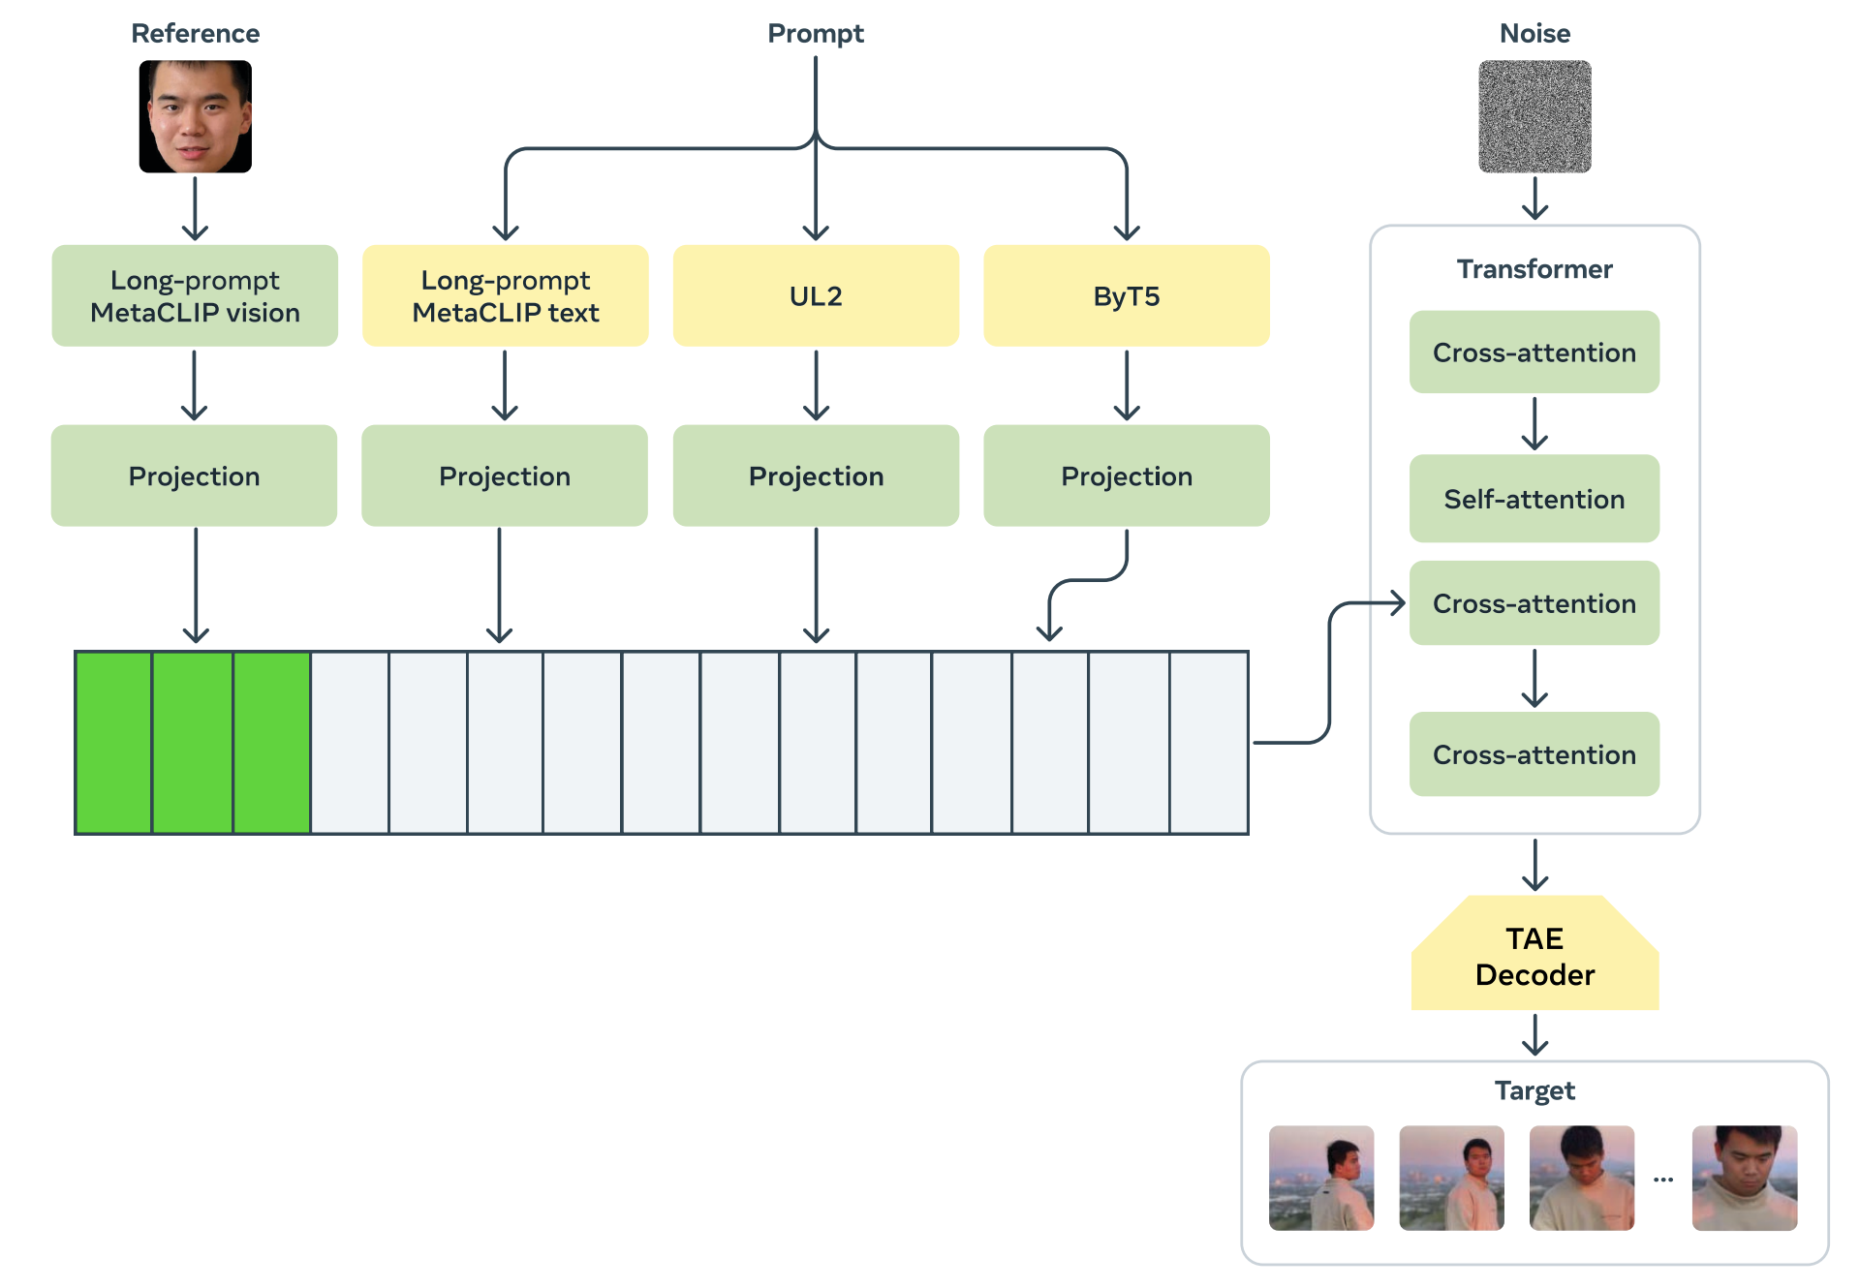
Movie Gen
Movie Gen Video (30B param video & image/single frame) → T2V, I2V Movie Gen Audio (13B param) → V2A, T2A
Post-Training Models: Personalized Movie Gen Video → specific person Movie Gen Edit → text-guided video editing
Specializes in HD videos upto 16 secs
Architecture:
Transformer backbone
TAE (temporal autoencoder) to encode video & image into a compressed latent space
Flow Matching to train generation (instead of diffusion – no denoising steps)
TAE decoder maps latent output into pixel space, VAE decoder used to upsample (768p → HD)
Notes:
Finally, we will briefly go over today’s optional paper, which was on Meta’s Video Generation model – Movie Gen
Movie Gen has 2 core models – Video (explain) & Audio
It also offers 2 post-training models (explain) At a high-level, the architecture is of a transformer backbone with temporal autoencoders that encode RGB video & images into a compressed latent space
One unique thing Movie Gen does is using Flow Matching instead of diffusion
TAE decoder is used for efficiency and generation of the output image, which is then fed into a VAE decoder (similar to CogVideoX) for HD unsampling

Slide 27
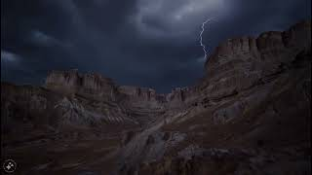
Movie Gen
https://go.fb.me/MovieGenResearchVideos
Notes:
Link from paper ~ Check link for all Movie Gen demos

Slide 28
Comparison / Summary
 | VideoPoet (Google) | CogVideoX (Open Source) | Movie Gen (Meta)
Arch. | Decoder-only transformer with visual, audio, text tokenization | Diffusion transformer with 3D VAE and expert transformer | Transformer backbone with TAE and flow matching training instead of traditional diffusion
Results | 2 seconds (default) 10 seconds (max) 8 fps (?) | 768 × 1360 pixels 10 seconds 16 fps | 1080p HD videos 16 seconds 16 fps
Zero-shot | Specialized for zero-shot | Less/not capable of zero-shot. Focus on strong text-video alignment | Capable of zero/one-shot
Audio: Visual: | Uses RVQ-levels - | - Uses VAE decoder | Omits RVQ Uses VAE decoder
Notes:
Lasya

